Slide 1


Biofuel Tech

Slide 2

Page #5
Overview
KKOG Hemp biofuel refers to renewable fuels produced from the industrial hemp plant (Cannabis sativa L.), specifically from hemp seeds and stalks. Two major types of hemp-based fuels are:
Hemp Biodiesel: Made from hemp seed oil through transesterification.
Hemp Ethanol / Methanol: Made from hemp stalks via fermentation or gasification.
Both can be used in marine engines, trucks, generators, and agricultural machinery, with no engine modification.

Slide 3
Page #5
Hemp Oil Extraction Process (Feedstock Preparation)
Harvesting and Drying
Seed Cleaning
Mechanical Oil Extraction
Oil Filtration and Degumming
Hemp plants are cut when seeds mature (~100-120 days).
Seeds are separated from stalks via proprietary mechanical threshing.
Moisture content is reduced to <10% before oil extraction to prevent spoilage.
Seeds are passed through vibrating sieves and air classifiers to remove debris.
Clean seeds are essential to prevent contamination during pressing.
Cold-Pressing:
Seeds are fed into a screw press or expeller at ~40–50°C.
Yields about 30–35% hemp seed oil by weight.
The remaining seed cake is high in protein and used for animal feed or biomass energy.
Solvent Extraction:
Use of ethanol to dissolve residual oil from pressed cake.
Solvent is recovered via distillation.
Total oil recovery: ~98% efficiency.
Filter through activated carbon or micron filters.
Degumming removes phospholipids, waxes, and resins.
Resulting oil: clear green-golden hemp seed oil (rich in unsaturated fatty acids).

Slide 4
Page #3
Conversion of Hemp Oil to Biodiesel (Transesterification)
The transesterification process converts triglycerides (fats/oils) into Fatty Acid Methyl Esters (FAME) — the chemical name for BIODIESEL.
Core Reaction:
Triglyceride + 3CH₃OH (methanol)
NaOH / KOH
3RCOOCH₃ (biodiesel) + Glycerol
Catalyst Preparation
Reaction
Separation
Purification
Final Product
Mix methanol to form sodium methoxide.
Add hemp oil to the reactor
Reaction completes when mixture separates into two layers.
Allow to settle
Top layer: biodiesel (lighter).
Bottom layer: glycerol + impurities.
Wash biodiesel to remove soap, catalyst, and residual methanol.
Dry
Hemp Biodiesel (H-B100): pure, renewable, ready for use or blending.

Slide 5
Page #5
Fuel Properties of Hemp Biodiesel
Property | Hemp Biodiesel (H-B100) | Petroleum Diesel | Benefit
Energy Content | 37 MJ/kg | 45 MJ/kg | Slightly lower but cleaner combustion
Cetane Number | 52–58 | 45–55 | Better ignition quality
Viscosity (40°C) | 4.2–5.5 cSt | 2.5–4.5 cSt | Good lubrication
Flash Point | 160°C | 52°C | Safer to store and handle
Sulfur Content | <0.001% | 0.25–0.5% | Ultra-low emissions
Oxygen Content | ~11% | 0% | Promotes complete combustion
Biodegradability | >95% | <40% | Environmentally friendly

Slide 6
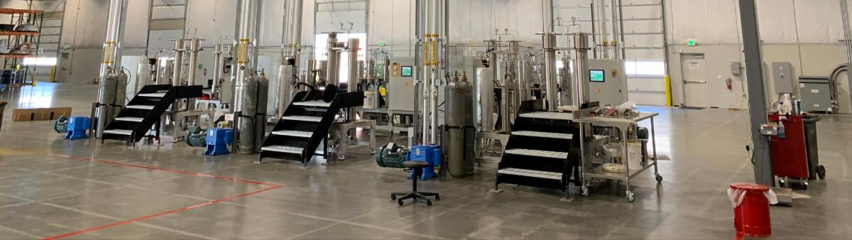
Page #4
Hemp Biofuel for Marine and Engine Applications
=
=
=
=
Marine Engines
Marine Blends
Land Transport and Agricultural Machinery
Stationary Power and Generators
Compatible with: low-speed and medium-speed diesel engines.
Applications: cargo vessels, fishing boats, ferries, offshore supply vessels.
Benefits:
Reduced SOx, CO, and PM (particulate matter).
Better lubricity, reducing wear on injectors and pistons.
Higher flash point, reducing onboard fire hazards.
B20: 20% hemp biodiesel + 80% marine diesel – standard for commercial fleets.
B100: used for inland or smaller vessels with clean fuel mandates.
Works in compression-ignition (CI) engines with no modification up to B20 blend.
Higher blends may require fuel filter upgrades
Hemp biodiesel powers diesel gensets, irrigation pumps, and microgrids.
Offers energy independence for rural or off-grid operations.

Slide 7
Page #5
Other Hemp- Based Fuels
=
=
Hemp Ethanol
Hemp Methanol & Syngas
Derived from fermenting cellulose in hemp stalks.
Pretreatment with acid or enzyme hydrolysis converts cellulose to glucose.
Yeast fermentation converts glucose to ethanol.
Pyrolysis or gasification of hemp biomass produces syngas (CO + H₂).
Syngas is catalytically converted to methanol, bio-oil, or hydrogen fuel.
C₆H₁₂O₆
2C₂H₅OH + ₂CO₂
Used as bioethanol fuel (E10–E85 blends) in spark-ignition engines.

Slide 8
Page #5
Environmental and Economic Benefits
Category | Hemp Biofuel Advantage
Carbon Neutrality | CO2 absorbed during hemp growth offsets emissions during combustion.
Soil Remediation | Hemp removes heavy metals and improves soil health (phytoremediation).
Low Input Crop | Minimal pesticides, deep roots prevent erosion, grows on marginal land.
Energy Security | Reduces dependence on imported fossil fuels.
Waste Utilization | Seed cake -> animal feed; stalks -> fiber, ethanol, or biomass energy.
Compliance | Meets EU RED II, U.S. EPA Renewable Fuel Standard, and IMO decarbonization goals.

Slide 9
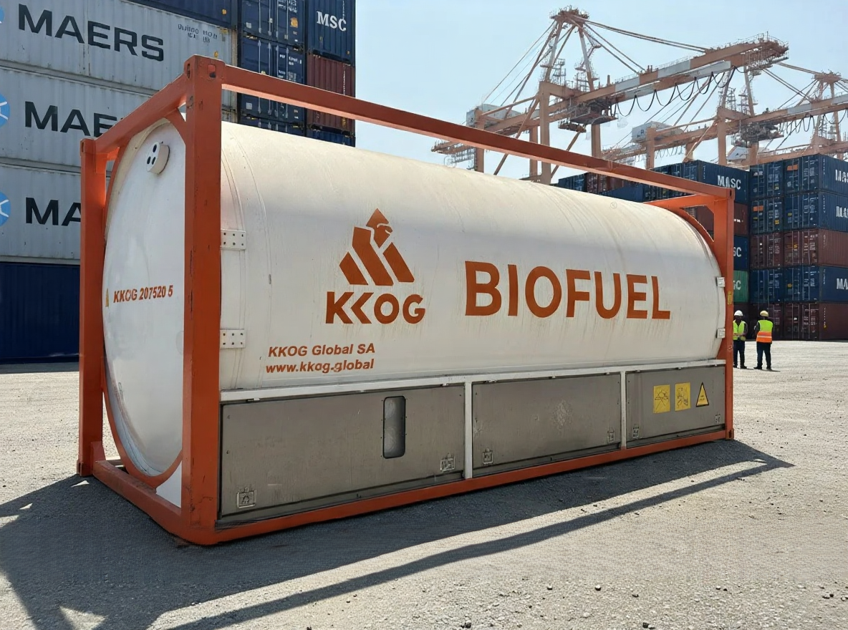
Page #5
Integration into Marine and Industrial Use
=
Marine Use Cases
IMO 2020 sulfur cap compliance: H-biodiesel’s sulfur-free nature helps meet <0.5% sulfur limits.
Hybrid engines: blends with LNG or hydrogen-ready systems for further emission reduction.
Retrofit feasibility: fuel storage and line cleaning required before switching.
=
Industrial Applications
Mining and construction equipment.
Backup power systems.
Agricultural tractors and harvesters.

Slide 10
Page #5
Strategic
Pillars
Hemp Seeds → Clean & Dry → Cold Press → Crude Oil
Solvent Recovery (optional)
Degumming & Filtration
Transesterification (Oil + Methanol + Catalyst)
Separation → Glycerol (byproduct)
Washing & Drying
Refined Hemp Biodiesel (H-B100)
Blending (B20/B50) → Marine or Diesel Engines

Slide 11
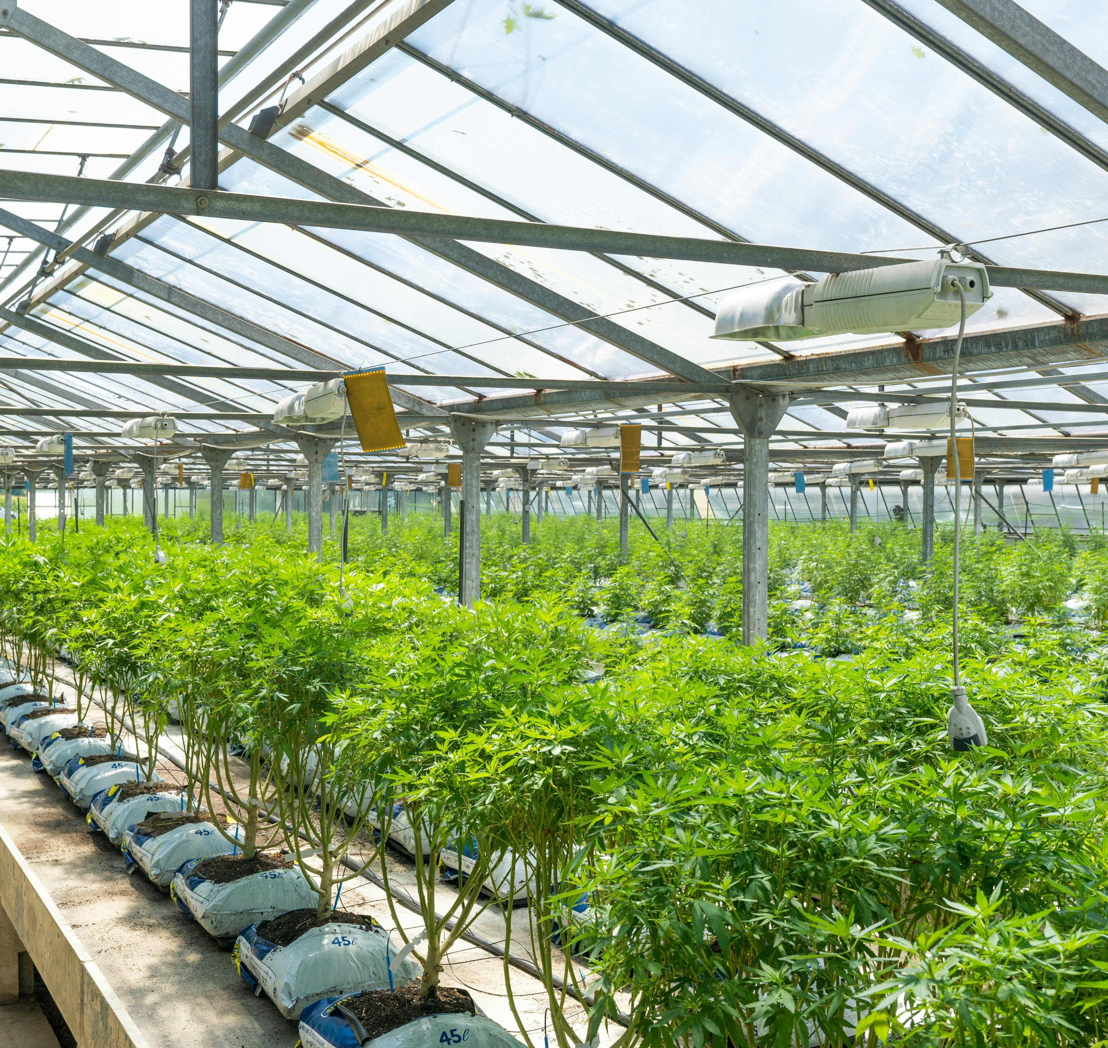
Page #5
Key Technical Takeaways
Yield
400 liters biodiesel per ton of hemp
Conversion Efficiency
90–95%
Byproducts
Glycerol (usable in cosmetics or biogas feedstock).
Energy Return on Investment (EROI)
3.5–5x.
Lifecycle GHG reduction
70–85% compared to fossil diesel.

